Slide 1

Crazy about
(OpenStreet)Mapping

Slide 2
Who am I?
Pieter Vander Vennet
Studied informatics
Heavy OSM-contributor
Works on a website to make contributing to OSM easier
Formerly worked for a small company on mobility (with OSM)
Bit crazy about mapping and OSM…
… I’ll tell you why

Slide 3


Slide 4


Slide 5
What is
OpenStreetMap?

Slide 6

Freedom to add data

Slide 7
Freedom to add data
As long as it is verifiable on the ground
As long as it is somewhat permanent
As long as no copyright is infringed
Go add your specific needs!

Slide 8
28
active pieces of software
to edit OpenStreetMap with
as of dec ‘20
(and around 15 deprecated)

Slide 9
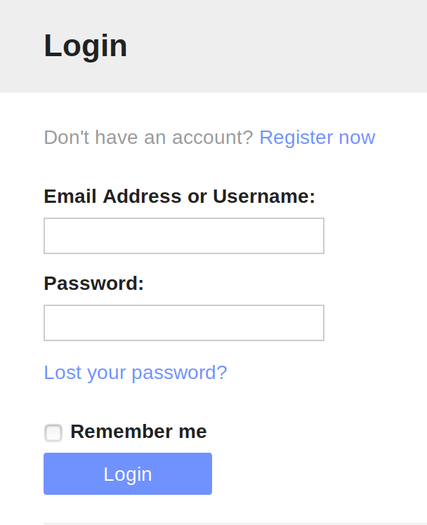
Creating an account

Slide 10
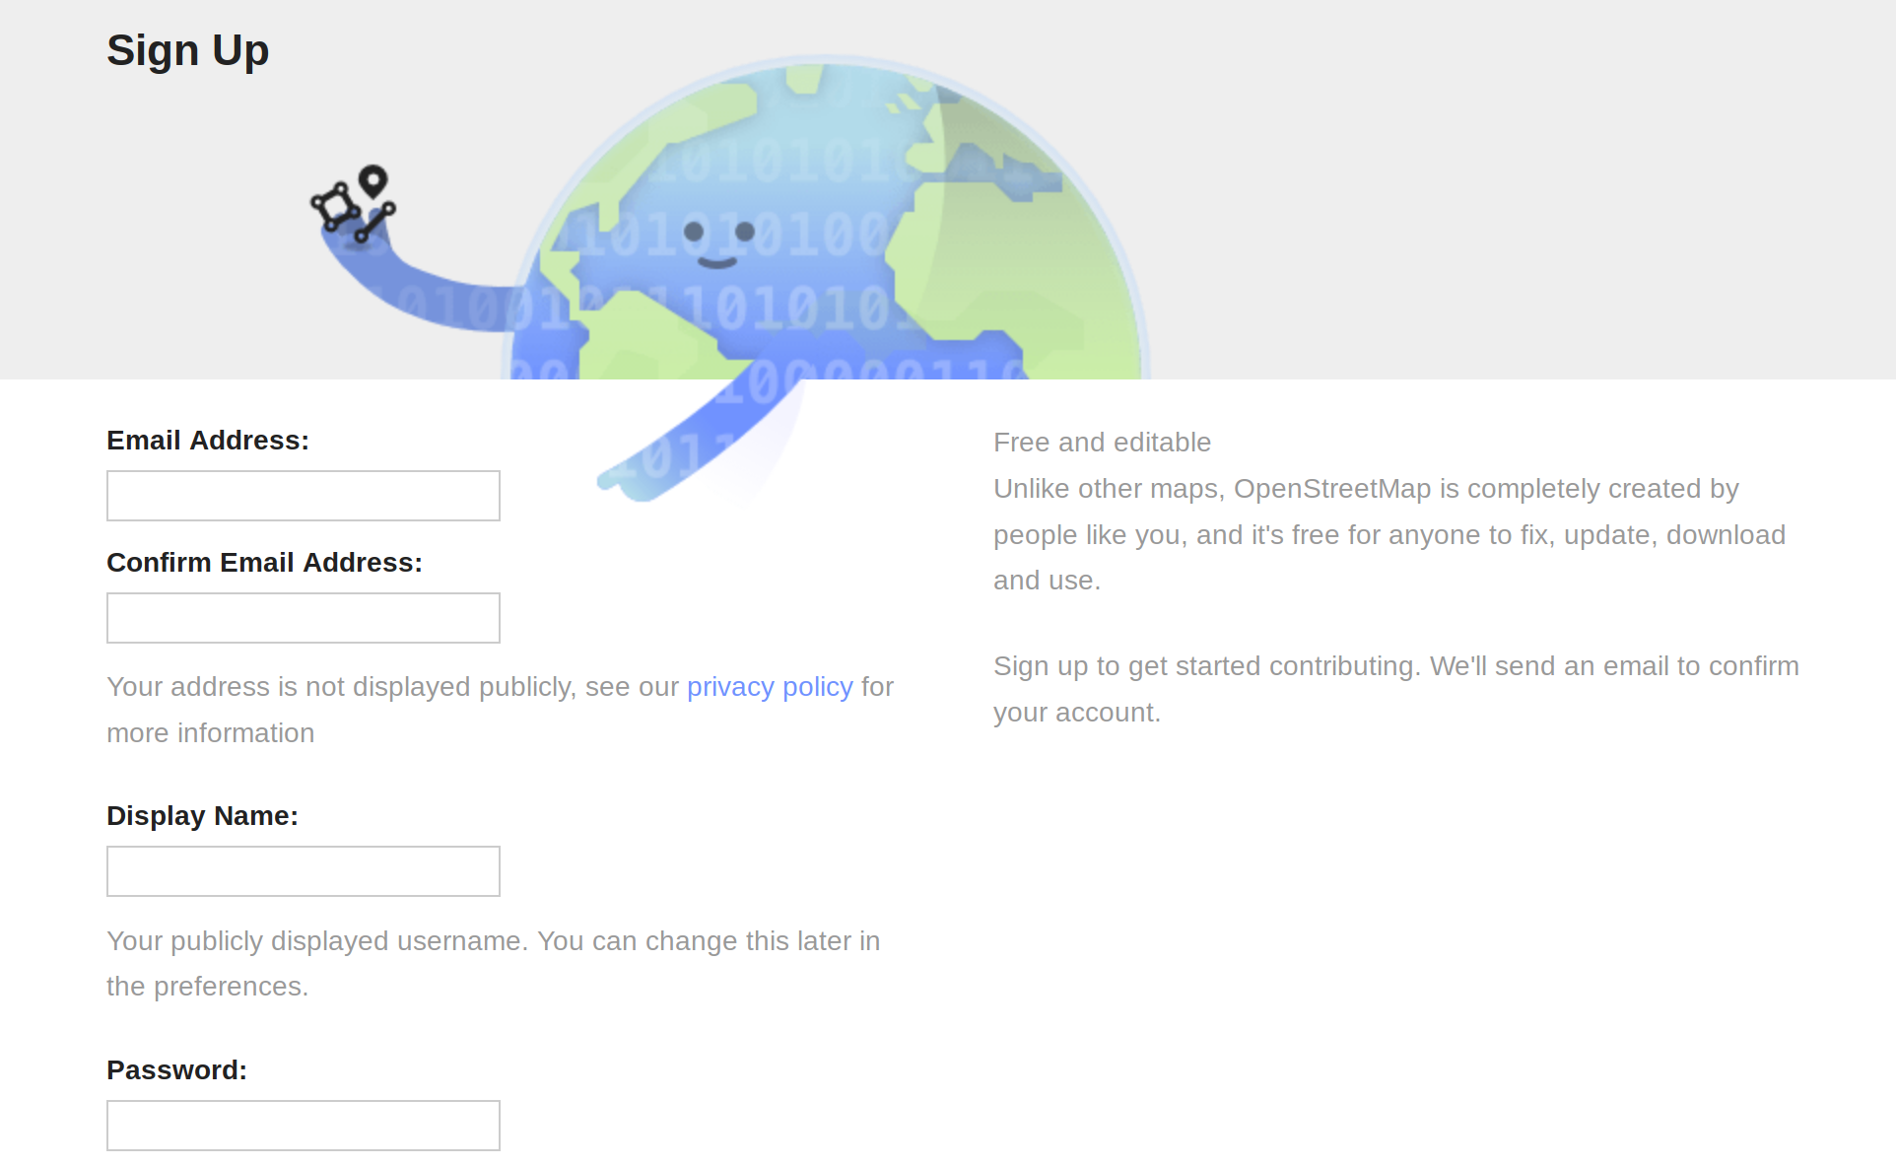
Creating an account

Slide 11

Creating an account

Slide 12
Geospatial data

Slide 13
Geospatial data
Lines and dots
+
Some information
on each line and dot

Slide 14

Tags (attributes)

Slide 15

Tags (attributes)

Slide 16

Tags (attributes)
The property we are describing (Key)
The value of the property
(Value)

Slide 17
Euhm…
I don’t know any of those tags
A tremendous lot is known by the editor
Something special: have a look on wiki.osm.org
Ask the community (of the country where you are mapping)
Still no answer? Invent something, in collaboration with the community

Slide 18

Editing (attributes)
While editing on osm.org:
don’t forget to click ‘save’ to actually upload.
This creates a ‘changeset’ (~commit)

Slide 19
Dataflow
small changes
OpenStreetMap.org Database
t
Contributors

Slide 20
Dataflow
OpenStreetMap.org Map
t
small changes
OsmAnd app
OpenStreetMap.org Database
t
t
overpass-turbo.eu
t
t
researchers
t
Contributors
t
Wikipedia
t
Pokemon Go
….....
….

Slide 21
What is
OpenStreetMap?

Slide 22
Crowdsourced

Slide 24


Slide 25


Slide 26


Slide 27


Slide 28


Slide 29


Slide 30
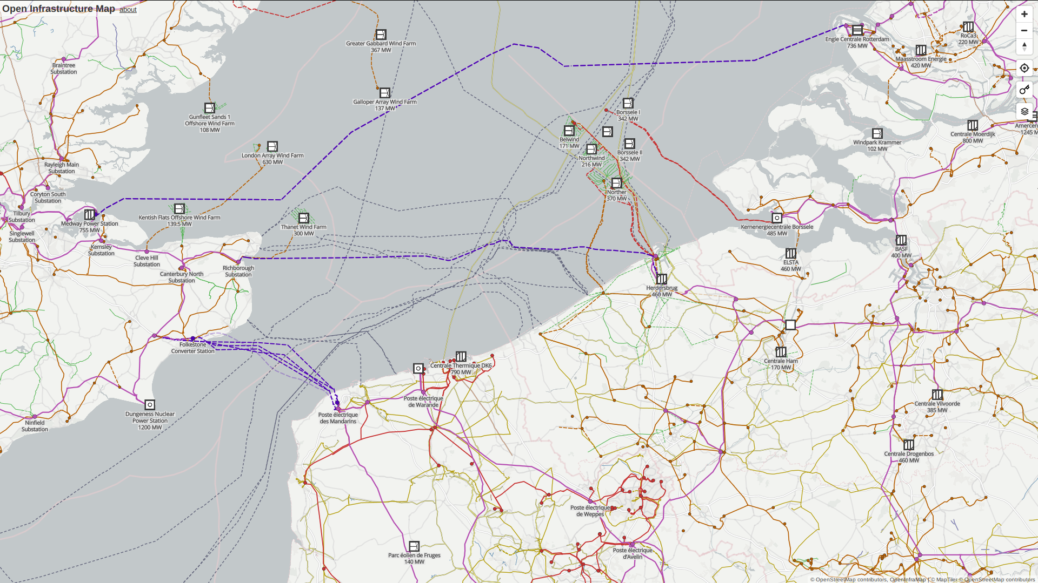

Slide 31
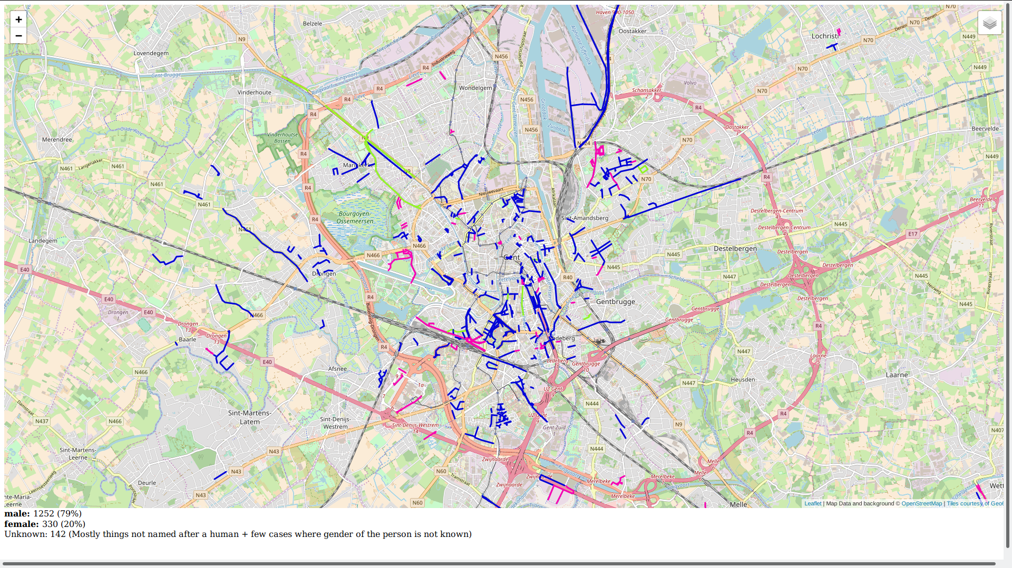


Slide 32
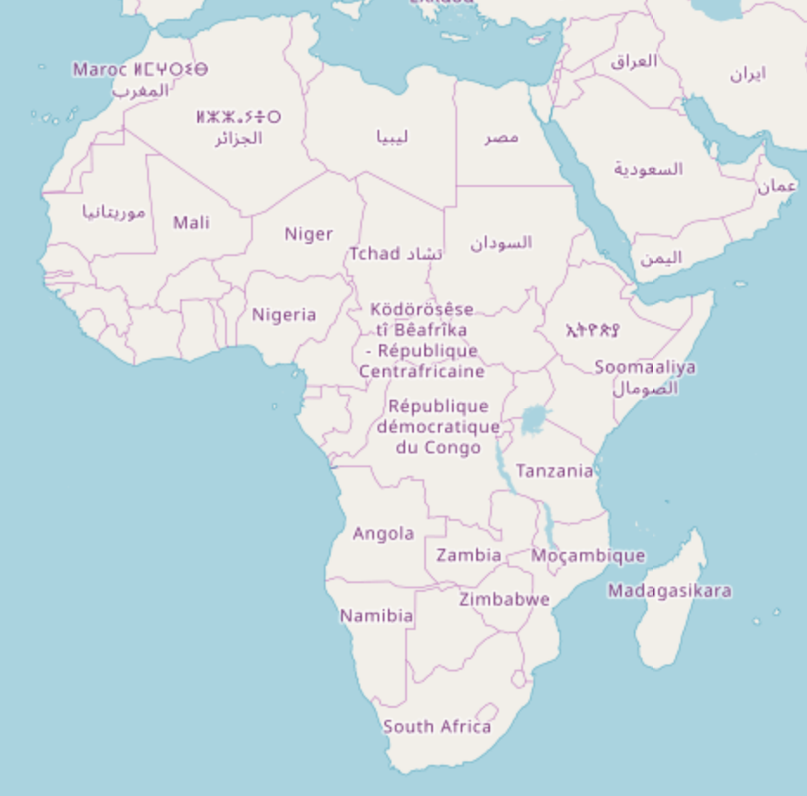

Slide 33


Slide 34



Slide 35
Saving lives

Slide 36
What is
OpenStreetMap?

Slide 37

A license: ODbL
Open Database License
You can use the data how you like
as long as you give attribution
and keep the data open

Slide 38
Tons of apps, tools and websites, ...
Big and sometimes confusing ecosystem
Tools and businesses grow (and sometimes die)
An overview of the most important ones are here

Slide 39




OsmAnd

Slide 40
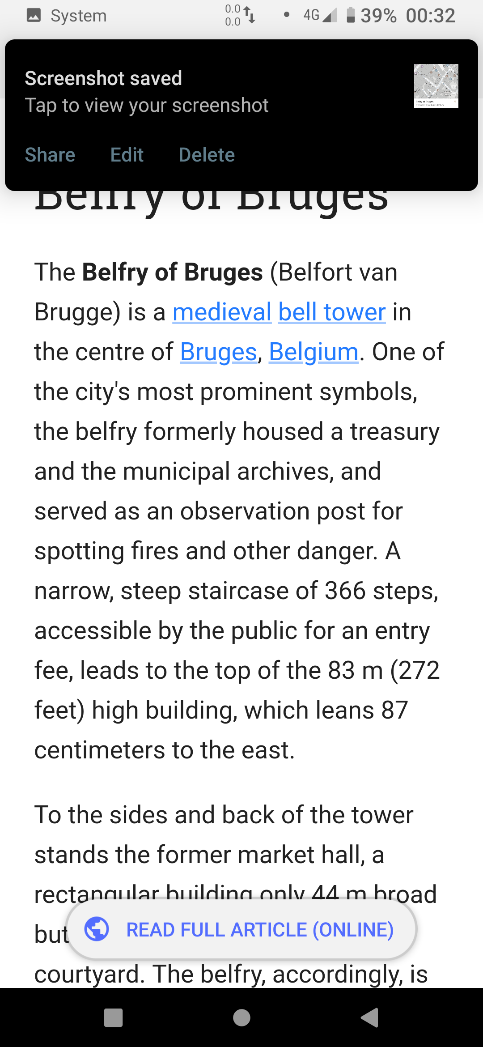
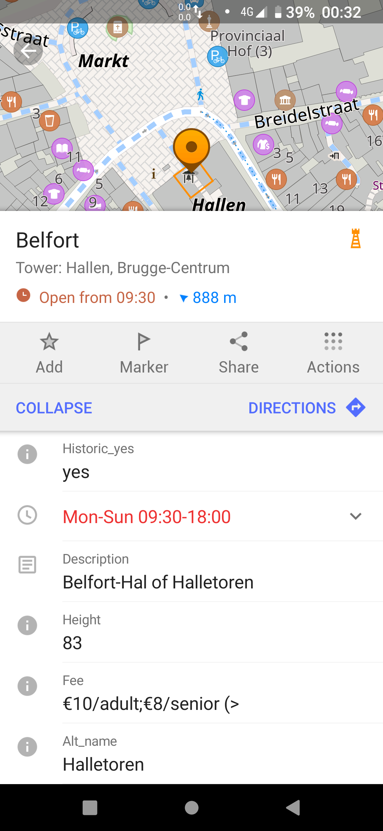
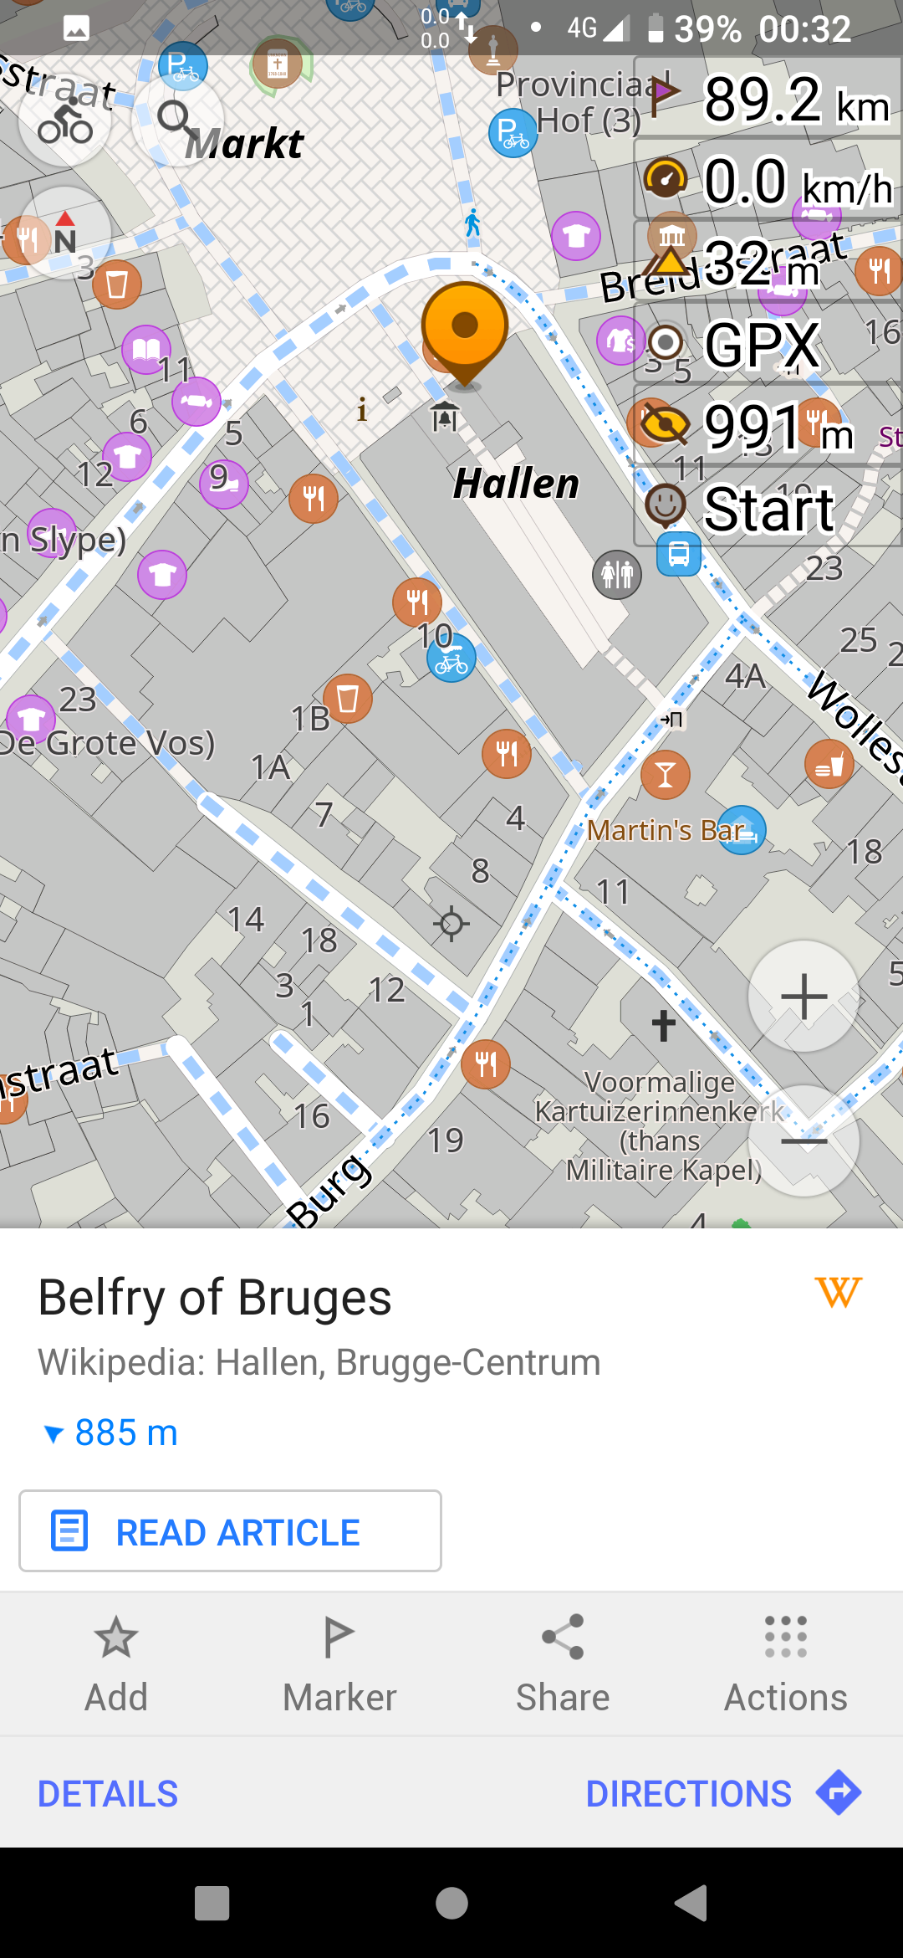

OsmAnd

Slide 41
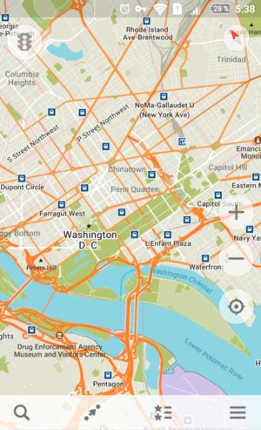
Organic Maps

Slide 42
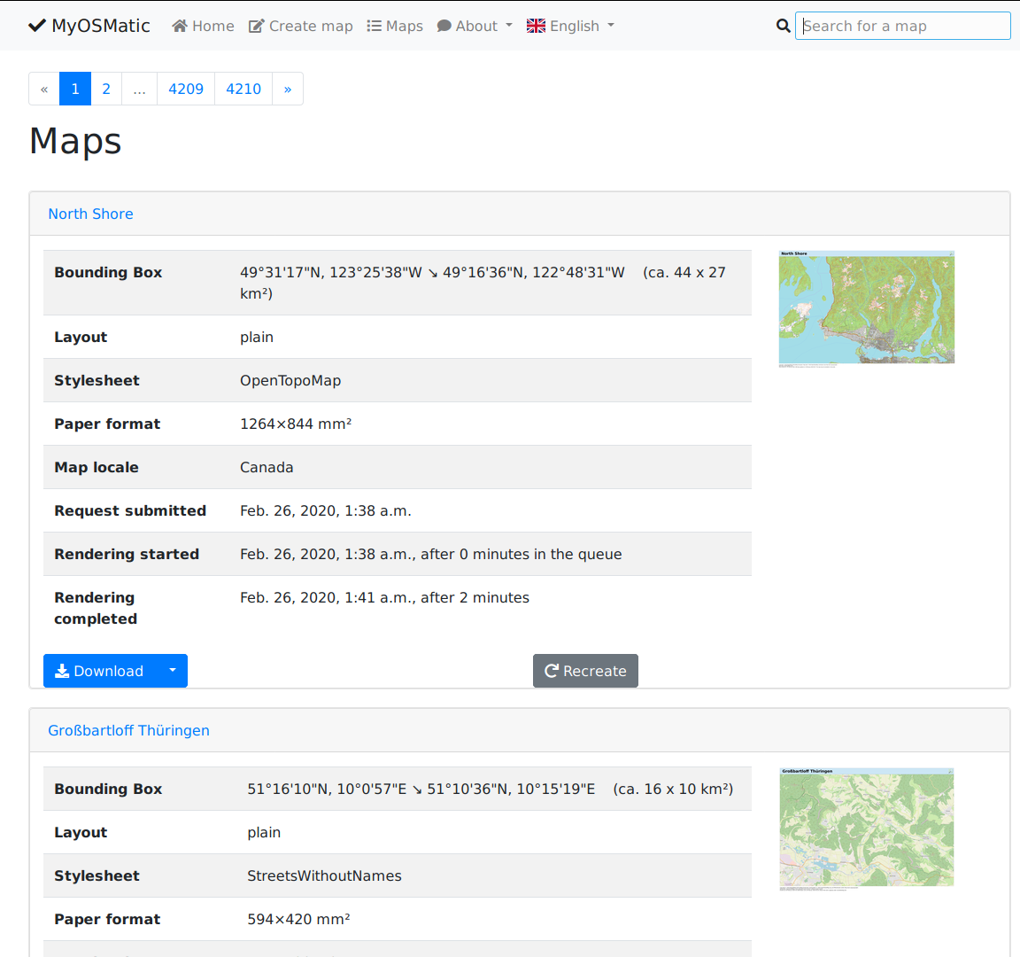
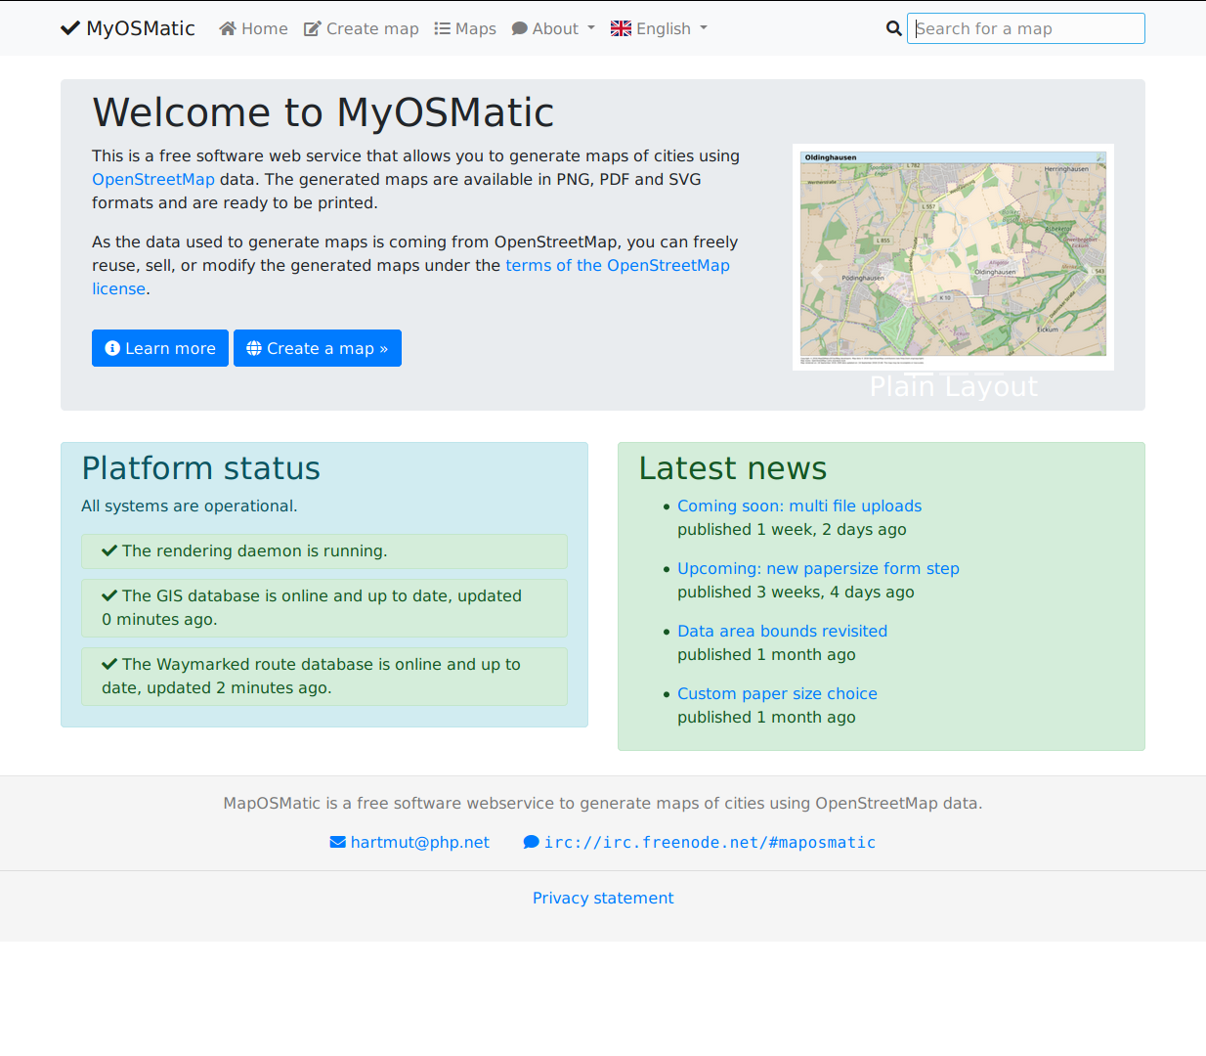
On paper: maposmatic

Slide 43


Slide 44

https://demo.f4map.com

Slide 45

https://demo.f4map.com

Slide 46
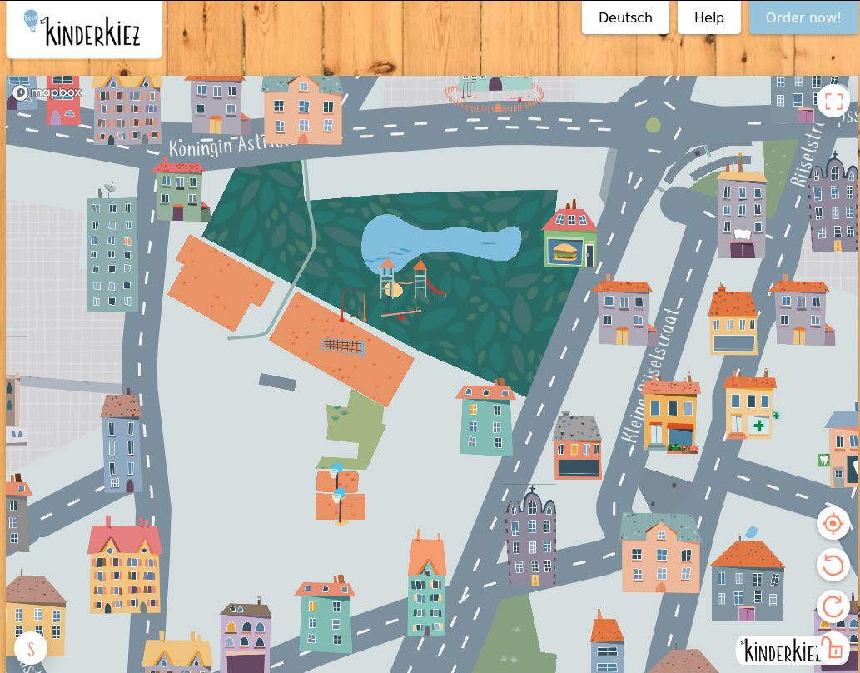
https://kinderkiez.net

Slide 47
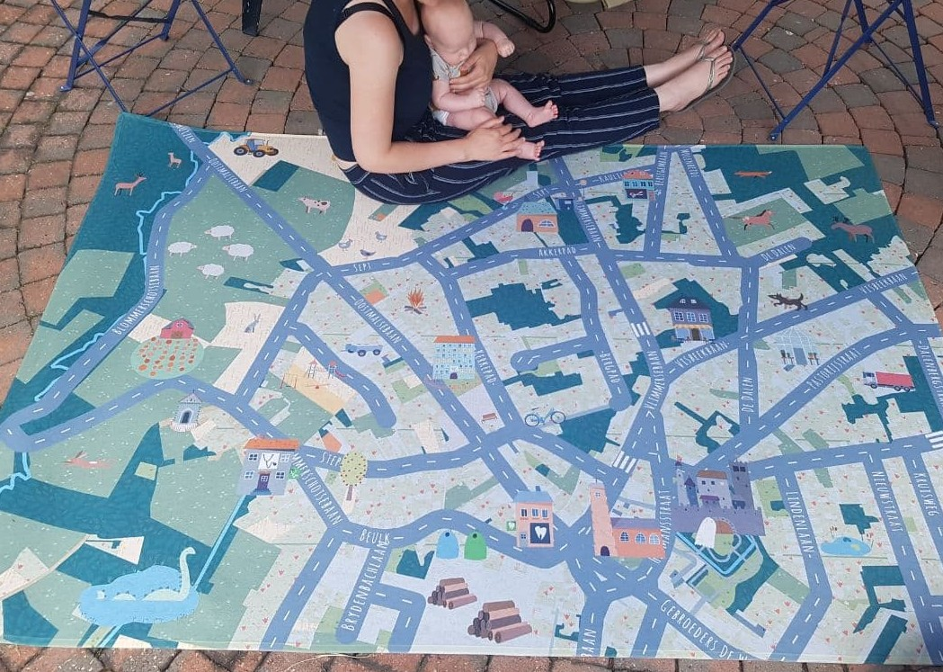

https://kinderkiez.net

Slide 48
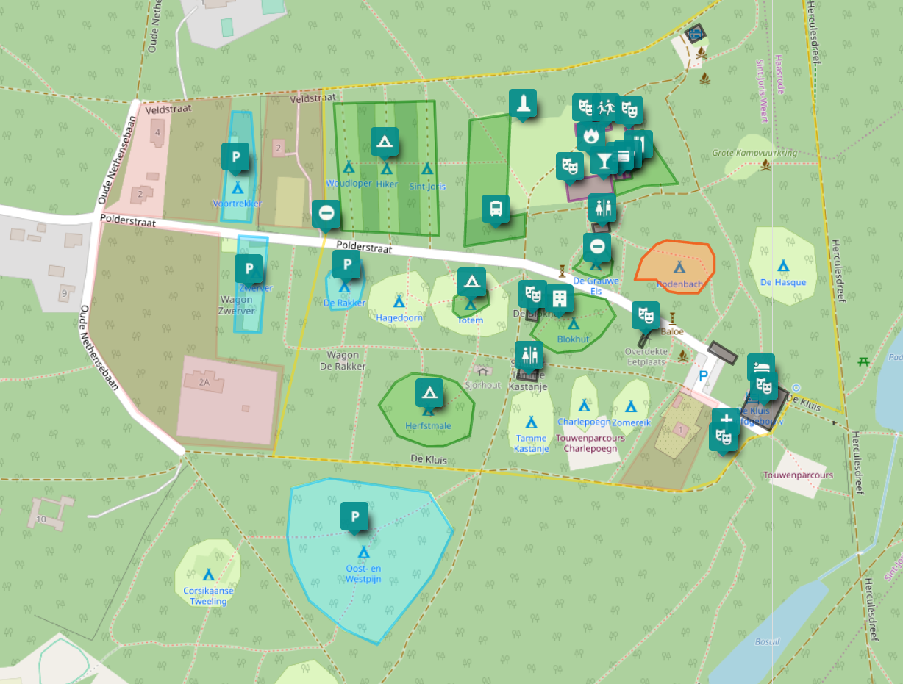
Umap.openstreetmap.fr
Ideal to add geodata not suited for OSM itself
  Preparing an event
  Planning an outing
  ...

Slide 49
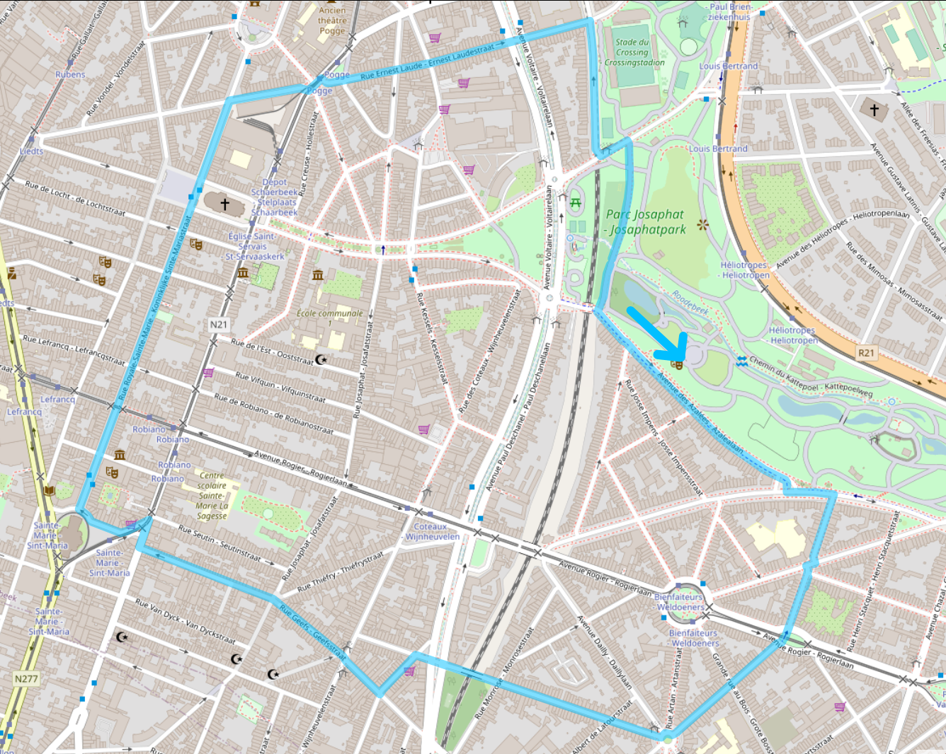
UMap

Slide 50

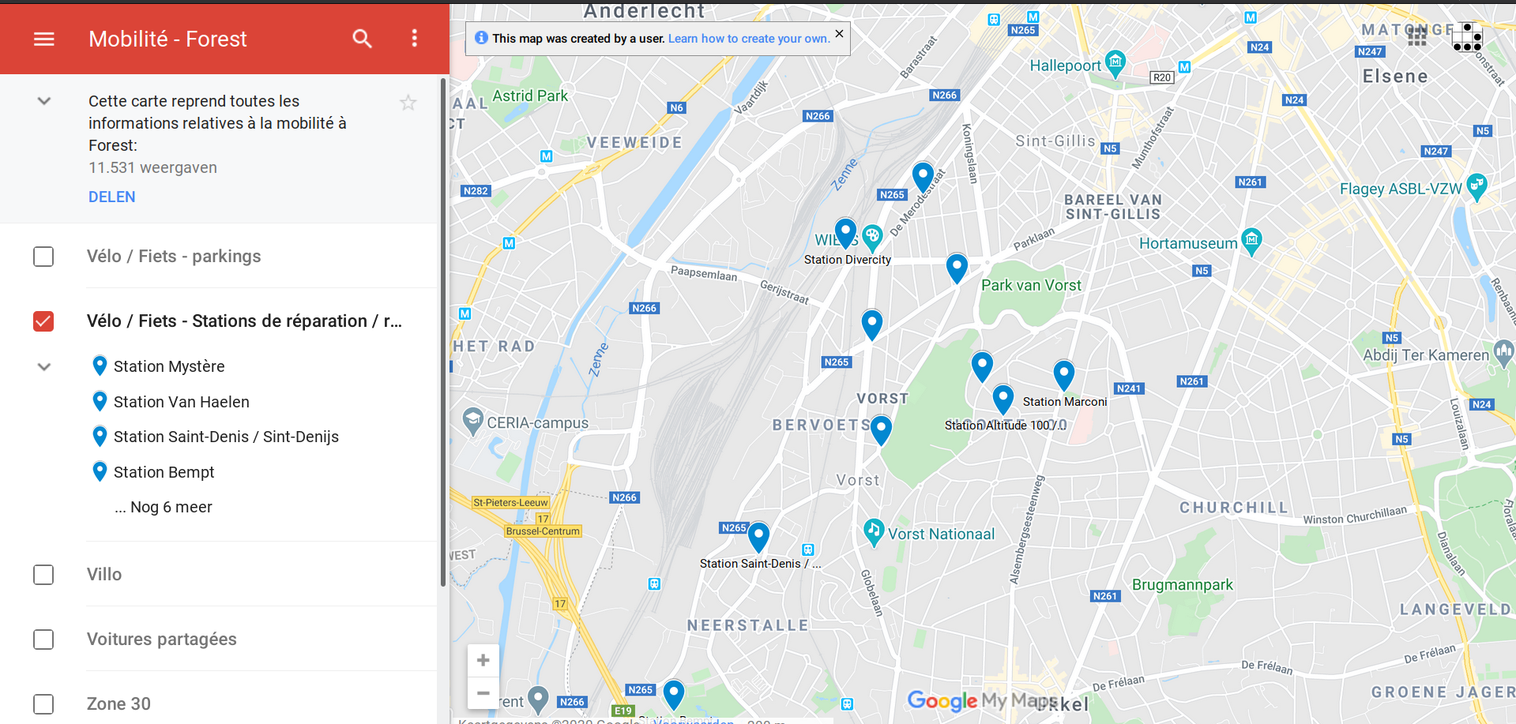
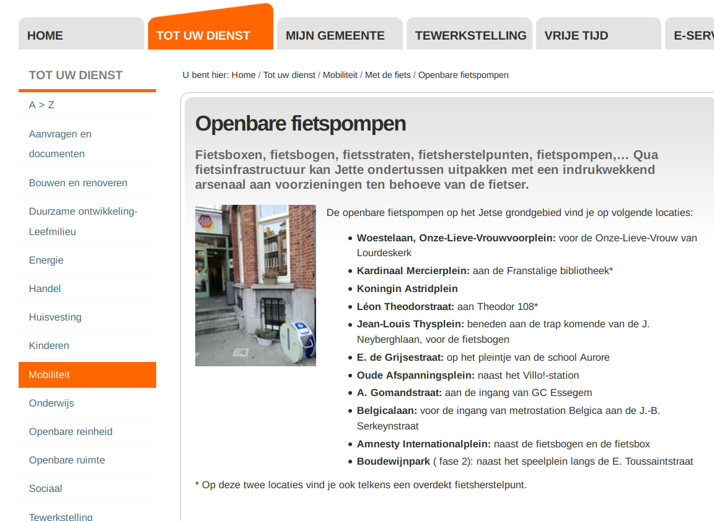
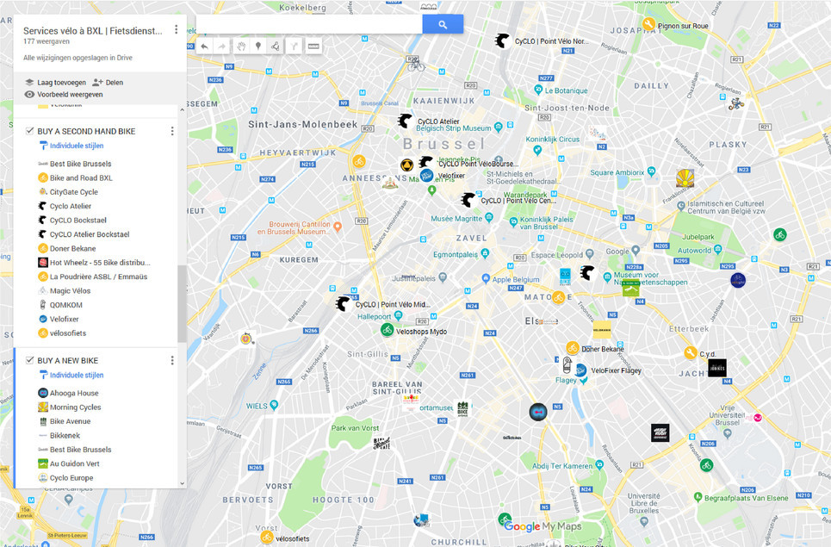

Slide 51
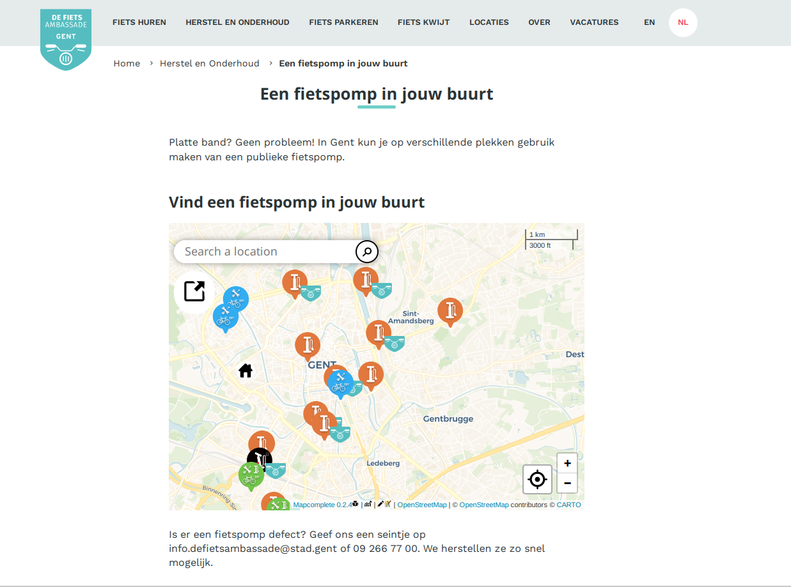

Slide 52
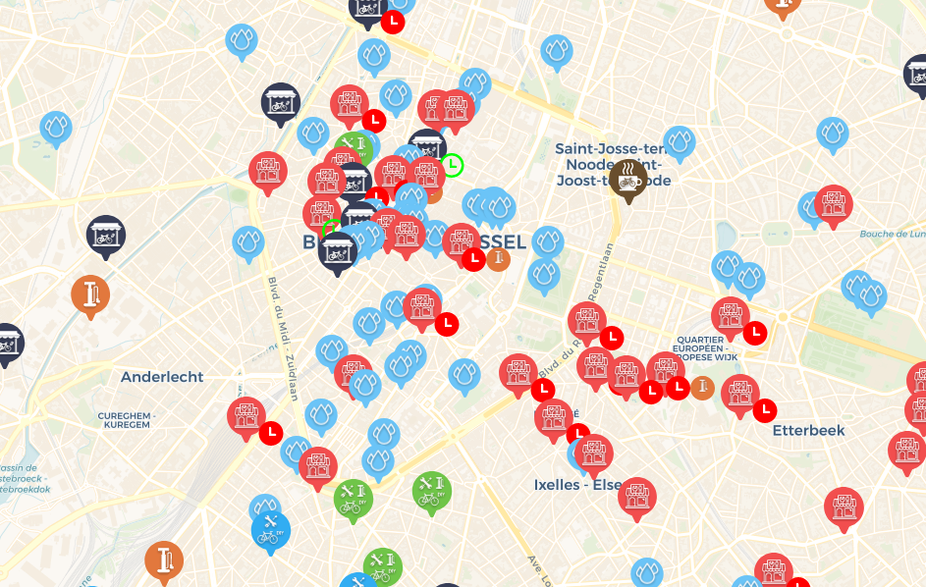

Slide 53
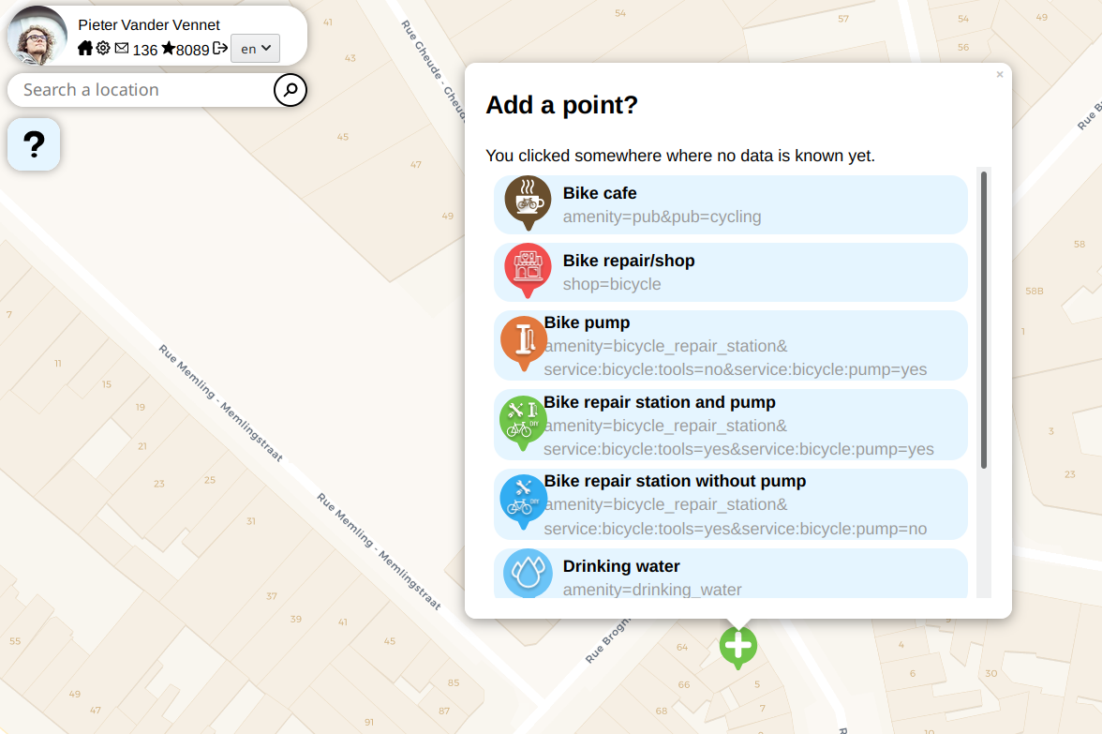
MapComplete.osm.be

Slide 54
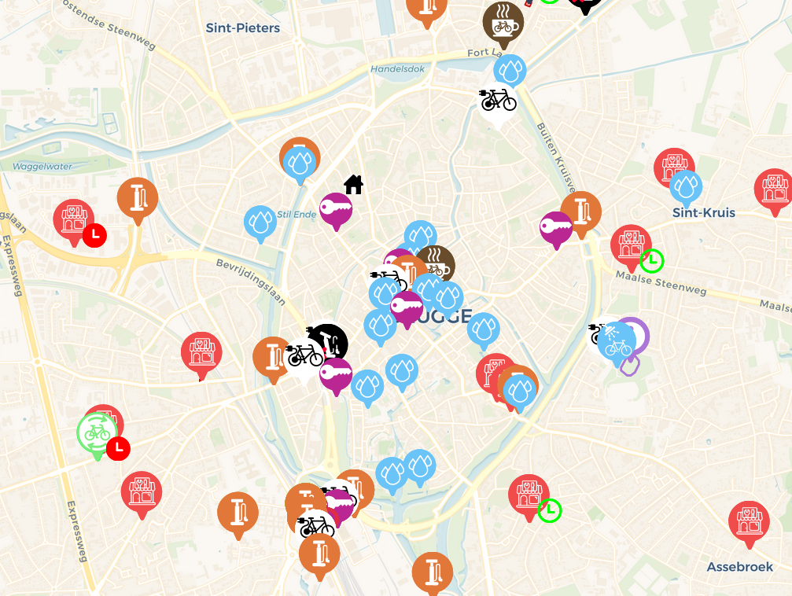
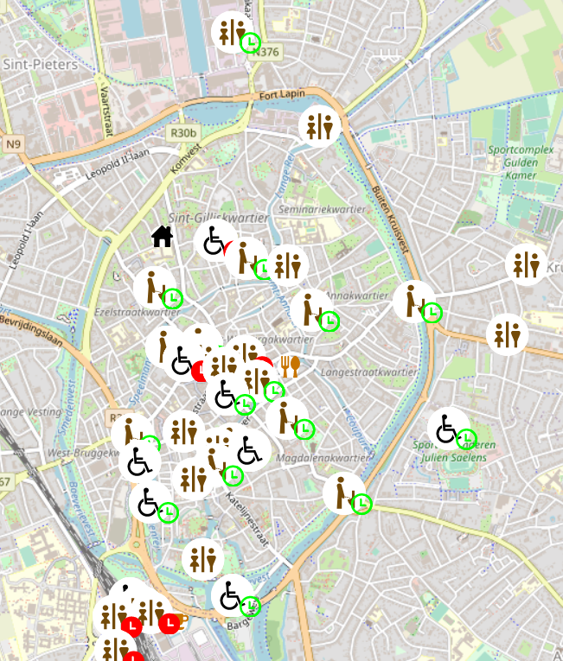
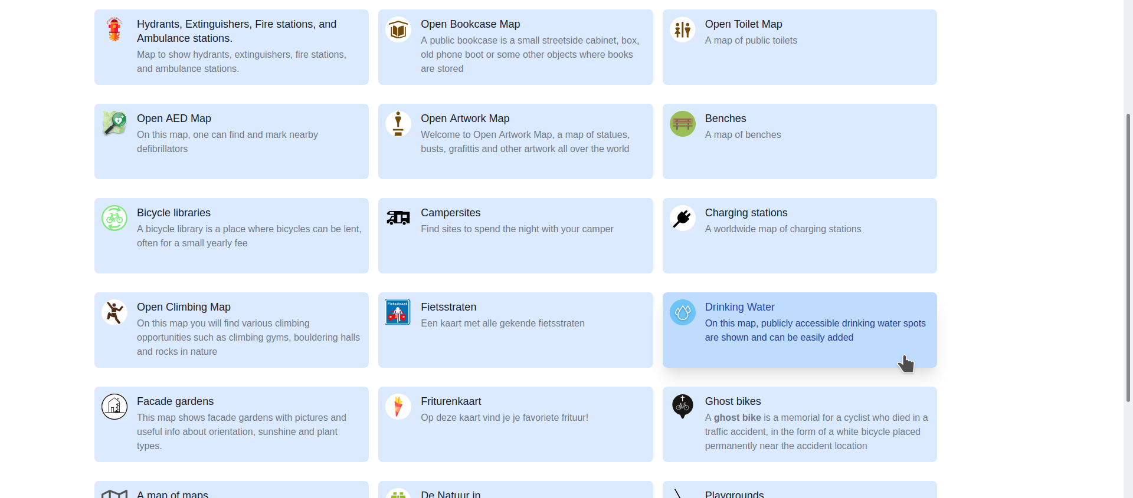
MapComplete.org
Website (PWA)
See features on a single topic
Add and edit those features
Excellent first contributor tool

Slide 55
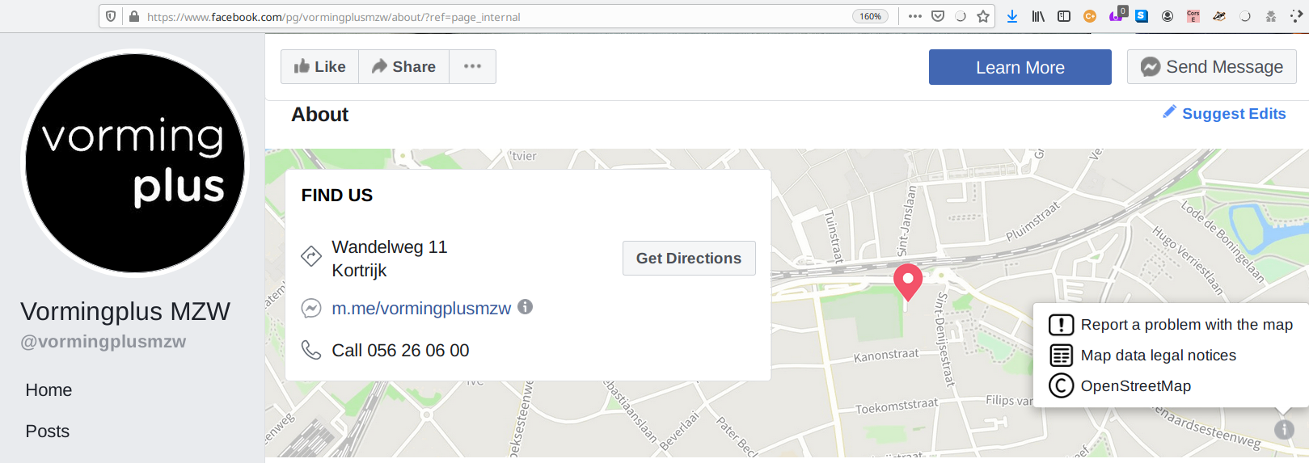


Slide 56
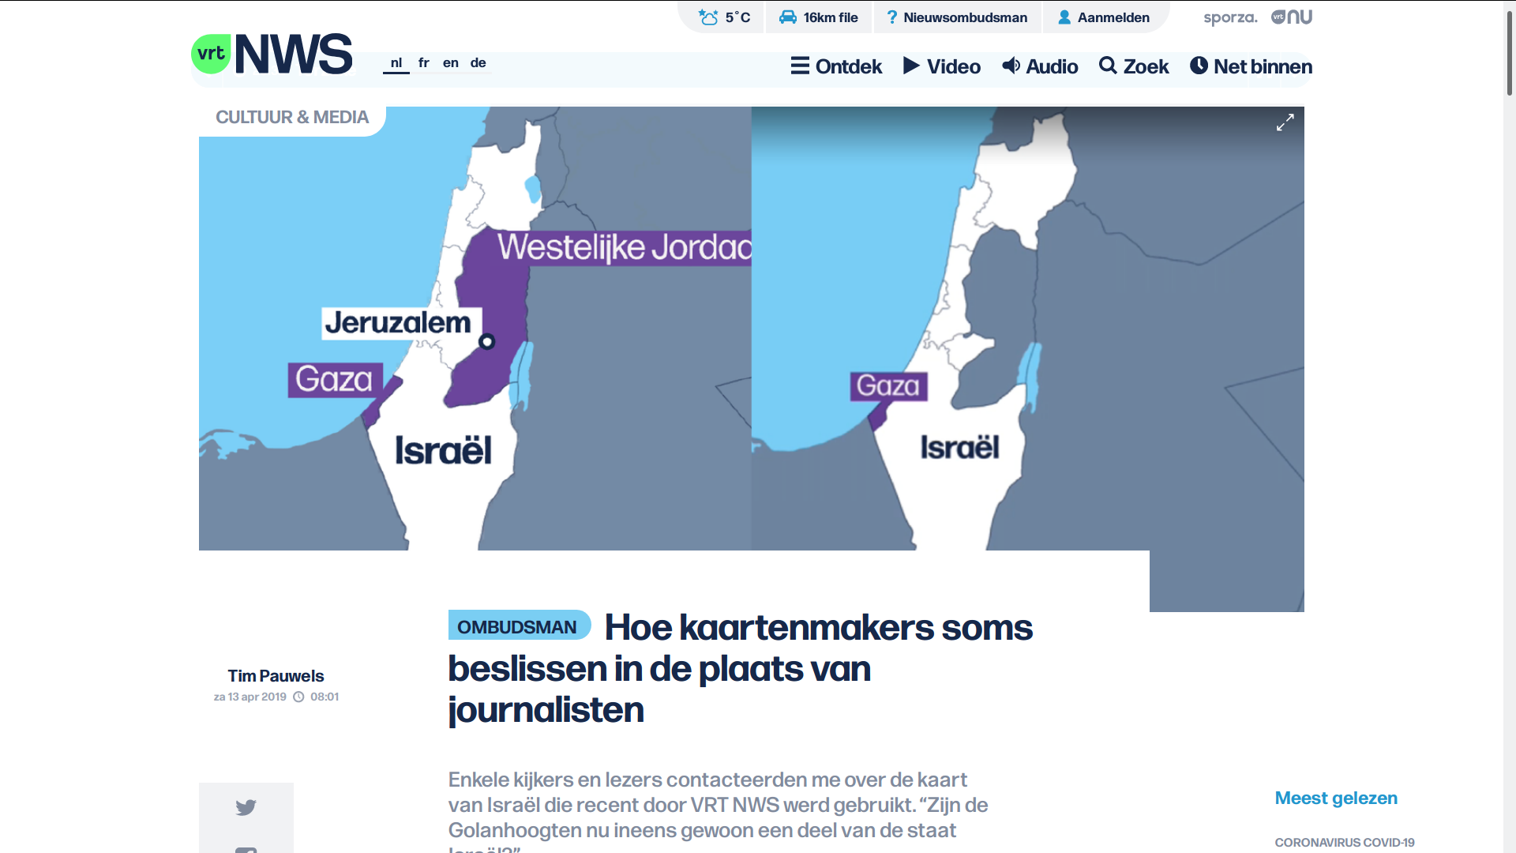

Slide 57

Szell, M. (2018). Crowdsourced Quantification and Visualization of Urban Mobility Space Inequality. Urban Planning, 3(1), 1-20. doi:http://dx.doi.org/10.17645/up.v3i1.1209

Slide 58
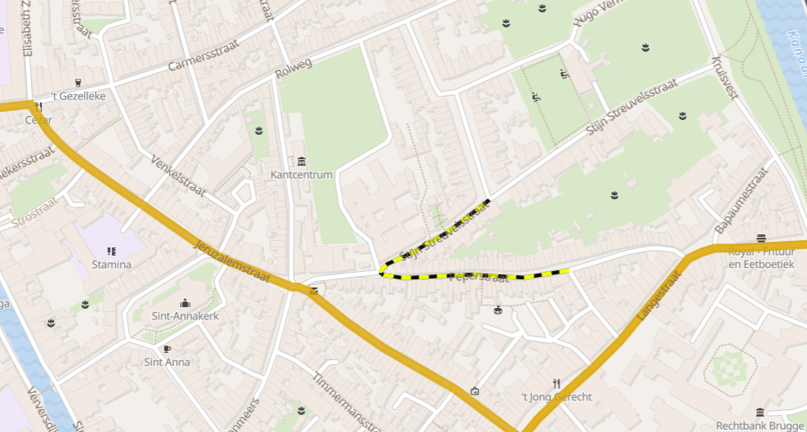
Mobility analysis sandbox to experiment
Disclaimer:
this is slide is shameless self-promotion
for anyways.eu

Slide 59
Custom queries: overpass-turbo.eu

Slide 60
Getting specific data
Where are all the chimneys/hairdressers/roads with cobblestone/… in … ?
Ask overpass!

Slide 61
Overpass
Easily query the OSM-database
Can be used to create an on-the-fly, automatically up-to-date map*
Lots of complicated features
10’000 queries/(day*project)
(* often a few minutes behind osm.org)

Slide 62
Overpass-turbo.eu
Where are all the chimneys/hairdressers/roads with cobblestone/… in … ?
Ask overpass!

Slide 63
Using overpass-turbo
Lookup the tag(s) on wiki.osm.org
Go to overpass-turbo.eu
Click ‘wizard’
Enter your query
  highway=* & surface=*
  natural=water | water=*
  natural=tree in Brussels
  …
Click ‘Build and run query’

Slide 64
Using overpass-turbo
Users of DuckDuckGo:
!wosm bicycle parking
!otw amenity=bicycle_parking
Done

Slide 65
Using overpass-turbo
Click ‘export’ to save as
GeoJson, GPX, XML, …
… or to get a URI to query in another app
  (such as JS to pass it to Leaflet)
Click ‘share’ to share with others

Slide 66
Pretty damn cool

Slide 67

What is
OpenStreetMap
NOT?

Slide 68
When did you last use a map?
Which map was it?
Why?
How much did you pay to use it?

Slide 69
Price of maintaining a map
Google Maps costs around
  ??? dollar/year

Slide 70
Price of maintaining a map
Google Maps costs around
  1 ‘000’000’000 dollar/year
  (This number is a rumor, no official sources exist)

Slide 71
Price of maintaining a map
Google Maps costs around
  1 billion dollar/year
  (This number is a rumor, no official sources exist)

Slide 72
Price of maintaining a map
Google Maps costs around
  1 billion dollar/year
  (This number is a rumor, no official sources exist)
Buying and creating satellite and map data
Google Streetview costs $200 ‘till $1150/km
Google bought Waze for 1.1 billion dollar

Slide 73
Price of maintaining a map
Similar amounts for other services
Google bought Waze for 1.1 billion dollar
Nokia bought Navteq for 8 billion dollar
and ‘burns’ 1 billion a year
Apple maps burns around 1 billion dollar/year
http://www.asymco.com/2012/12/18/how-much-to-maps-cost-and-what-are-they-worth/
http://www.asymco.com/2012/12/18/how-much-to-maps-cost-and-what-are-they-worth/

Slide 74

How much did you pay?
There is no such thing as free lunch

Slide 75


Slide 76
Notes:
Why are these shown? Why not a very recognizable spot? Such as the stations?

Slide 77

Google Maps is advertising
Google makes money by
placing ads on the map
giving some venues more priority in search
No incentive to map poor countries
“Google Maps only works within 100 miles of a starbucks”
Notes:
Who remembers this

Slide 78

Google Maps is tracking
Google tracks your searches and location through maps,
under the guise of features
“Share your location”, “Find my phone”, “Where am I?”
Very valuable information
Better ads
How effective is an ad pin?
...
Notes:
Who remembers this

Slide 79
Google Maps is a monopoly
Little incentive for other companies to provide cartography services,
cause ‘google maps is free anyways’ - the consumer
You can look to it, but not reuse anything
Google Maps uses lock-in-tricks
  Sudden price hike for devs (1th may 2018)
  Death by a thousand papercuts

Slide 80
… but
Google Maps does have more information
on shops and businesses
because everyone searches them there
(It’s even worse – a shop not on Google
“does not exist)
but this is changing!

Slide 81
… but
Google Maps does have more information
on shops and businesses
because everyone searches them there
(It’s even worse – a shop not on Google
“does not exist)
but this is changing!

Slide 82

OSM is catching up!
2007 2017

Slide 83
OSM is truly free
Free as in beer*
Free as in freedom
However, if you can afford it, donate back
Money for the server
Data – contribute yourself
Love – use it on the road and in your projects
Users – spread the word
*There are commercial, paid solutions too for heavy map users
However, as there are multiple players, it is affordable

Slide 84
What is
OpenStreetMap?

Slide 85
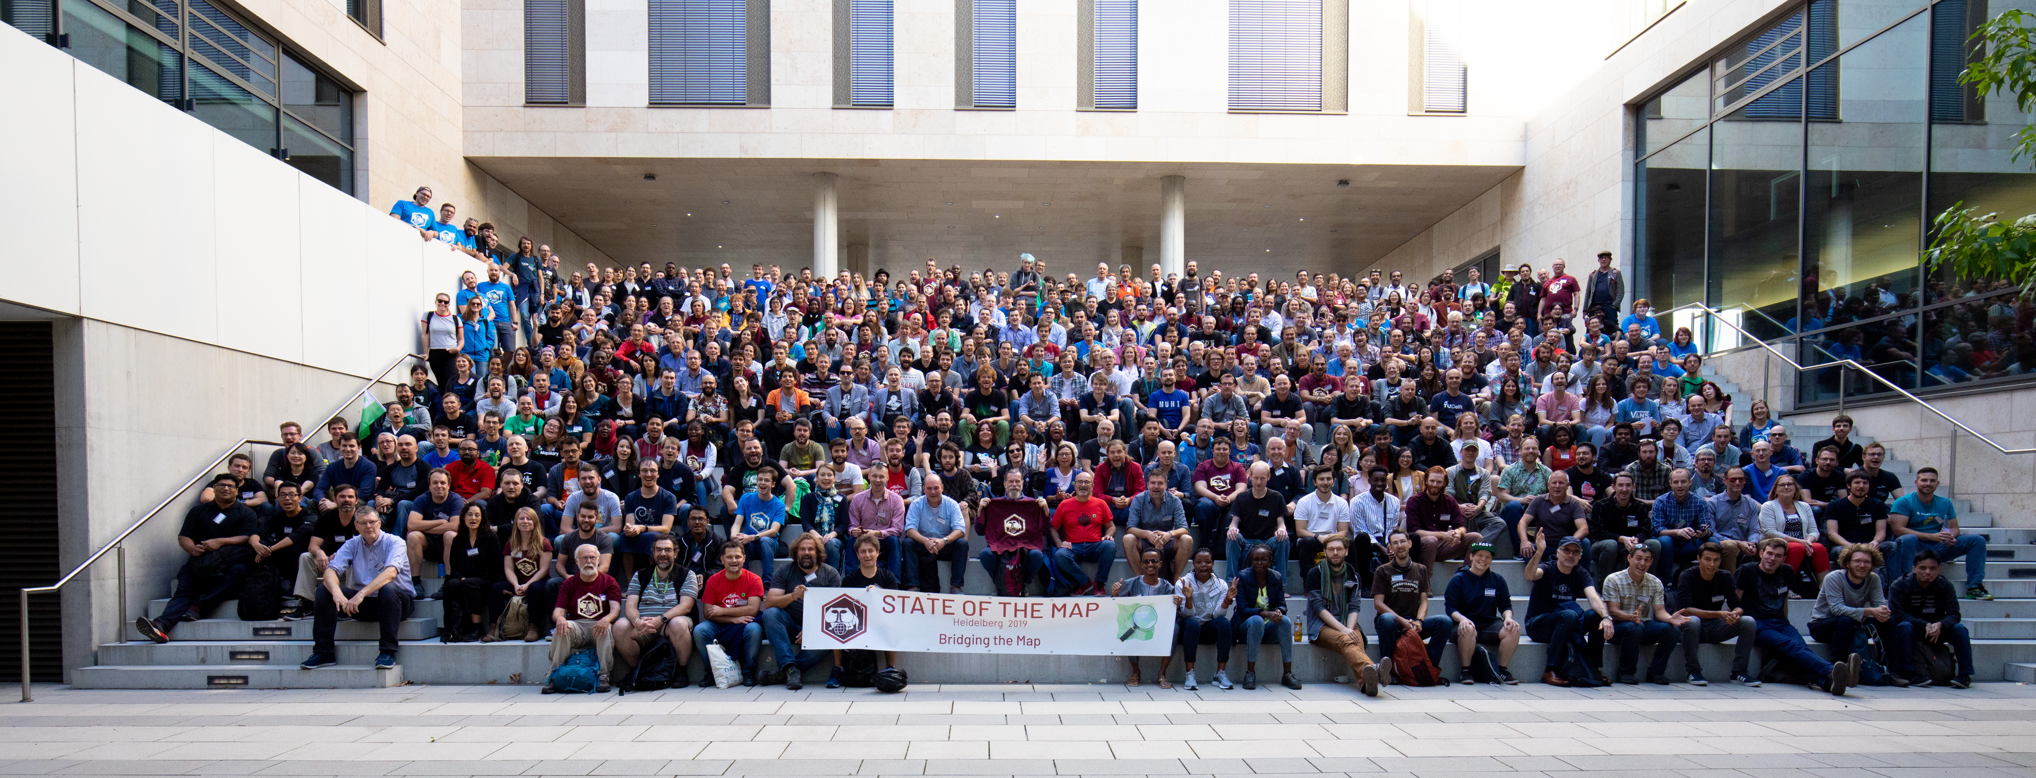
Community

Slide 86

The Belgian community does stuff
Osm.be
Find us on meetup.com
Talk to us on element.io (Matrix) (OSMBE - community)
Donate so we can buy 360° camera’s, stickers, vests, servers, …
Help our projects (map historical data, public bookcases, ...)

Slide 87
Working together

Slide 88
Working together on the most accurate, most detailed most up-to-date and most open global map

Slide 89
Working together on the most accurate, most detailed most up-to-date and most open global map and I’m crazy about it

